Slide 1
NETCD PROJECT 3
Chin Rui Bin S10169526J
Tay Jia Yi S10179524H
Joanna Seet S10163218G

Slide 2
RECAP

Slide 3

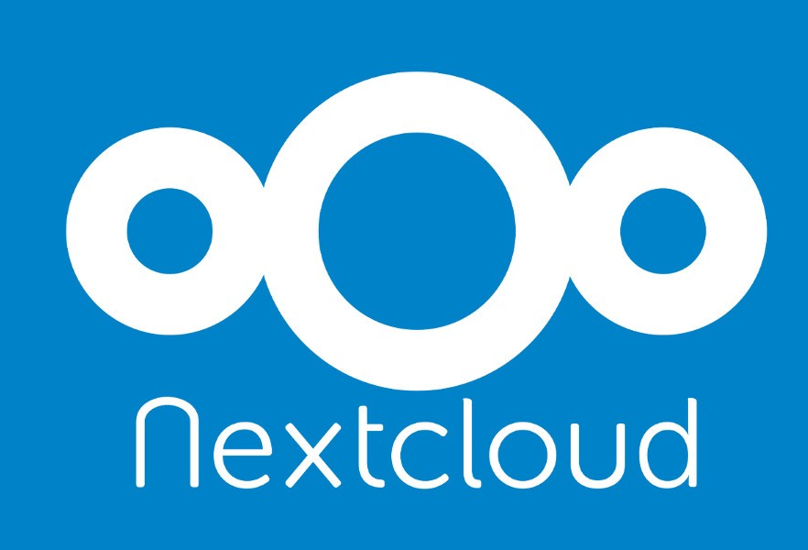
Previously on Project 2...

Slide 4
Project Deliverables
List all the security features that can be implemented for different cloud services. (Google security, DB Security, etc.)
List the security features that they have implemented on their cloud service that is running on their VM or laptop.
Explain the steps required to implement these security services.
Explain how the security services implemented can protect their cloud service.
Describe known vulnerabilities in the security services implemented for cloud computing.
Students may refer to various cloud security standards (both draft and approved standards) available online.
Submit a comprehensive report for the implementation of security services in your network cloud at the Mel website before the dead line.

Slide 5
Project Deliverables
Student should document the challenges faced when implementing the security services.
They should be able to demonstrate the effectiveness of the security services implemented such as locking the cloud services after 3 unsuccessful login and keeping a log of the suspected intrusion.
Student may use freeware or open source software to implement these features.
Additional marks will be given base on creative ideas in the implementation of security services which can enhance and secure the student’s cloud services offered.
These may include scanning of uploaded files and capturing any malware residing in the file that was uploaded to their cloud.

Slide 6
What are some security implementations for cloud services?

Slide 7
Security for Cloud Services
Google security
Cloud Security Command Center
Built-in security analytics
Event Threat Detection
Audit logs
Web application vulnerability detection
Notes:
Google Security
Cloud Security Command Center makes it easier for you to prevent, detect, and respond to threats.
See what assets in your GCP infrastructure are in violation of the CIS Benchmarks and take action.
Built-in security analytics and threat intelligence assesses the overall security state and activity of your virtual machines, network, and storage buckets and surfaces vulnerabilities in your applications.
Cloud Security Command Center reveals virtual machines that have been used for malicious purposes.
Event Threat Detection uses industry-leading threat intelligence, including Google Safe Browsing, to detect suspicious activity in your logs.
Reduce the amount of time you spend investigating logs and focus on high-risk events and remediation.

Slide 8
Security for Cloud Services
2. DB Security
Implementing strong and multifactor access + data management controls
Load/stress testing and capacity testing of a database
Physical security
Reviewing existing system for vulnerabilities
Notes:
DB Security
Restricting unauthorized access and use by implementing strong and multifactor access and data management controls
Load/stress testing and capacity testing of a database to ensure it does not crash in a distributed denial of service (DDoS) attack or user overload
Physical security of the database server and backup equipment from theft and natural disasters
Reviewing existing system for any known or unknown vulnerabilities and defining and implementing a road map/plan to mitigate them

Slide 9
Known vulnerabilities
Session Riding (Hijacking)
Virtual Machine Escape
Social Engineering
Notes:
Session riding happens when an attacker steals a user’s cookie to use the application in the name of the user.
Physical servers run vms on top of hypervisor. Attacker can exploit hypervisor by using vulnerability present in hypervisor.
Vm can escape virtual environ and gain access to hypervisor -> all vm running on top

Slide 10
Our Security Implementations
CloudFlare
ClamAV
Logging + Monitoring
Activity Notifications
Emails
Encryption
Azure Conditional Access
2FA - Nextcloud
Notes:
2FA done
What we done:
Cloudflare: DDoS, DNS, TLS, Hides origin server, web application firewall, JavaScript challenge
ClamAV: Antivirus can scan files uploaded to NextCloud
Logging and Monitoring, resource usage and logs
Activity notifications: Send emails when ppl do something
Email: Use mailgun to send emails, inc passwords reset or etc
Showed how to upgrade nextcloud version and fix DB using occ
Edit:
Encryption: Encryption at rest on the server
Edit 2:
MFA Enforcing on Azure Admins
Left: Azure AD SSO

Slide 11


Slide 12
Cloudflare
Web-infrastructure and web-security company
Used it to provide:
TLS
Content delivery network
Web application firewall
Javascript challenge
DNSSEC
DDoS protection

Slide 13
TLS
Cryptographic security protocol used to ensure that network communication is protected
Provides data integrity and communication privacy
Connection is private because data is encrypted before being transmitted
Identity of communicating parties are authenticated using public-key cryptography
Connection is reliable because each message includes integrity check to prevent loss or alteration of data during transmission

Slide 14
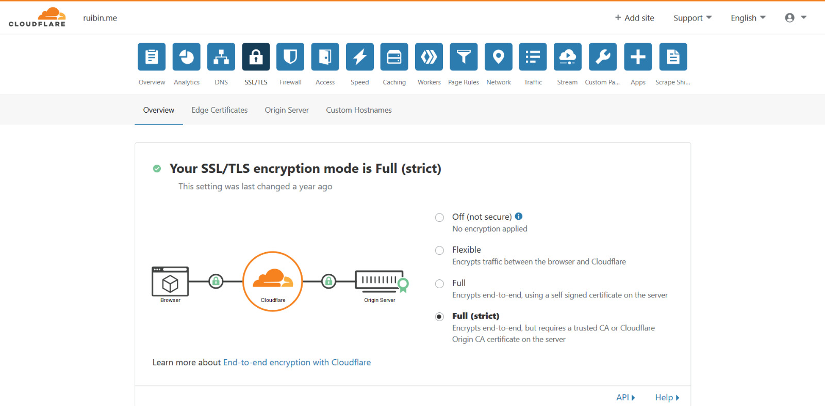
SSL/TLS
Notes:
Backend on the origin server is protected by Let’s Encrypt, a provider for free TLS certs with auto renewal. Hence, communications to cloudflare from the server are encrypted as well.
Alternatively, Cloudflare provides their own certificates for the origin server

Slide 15
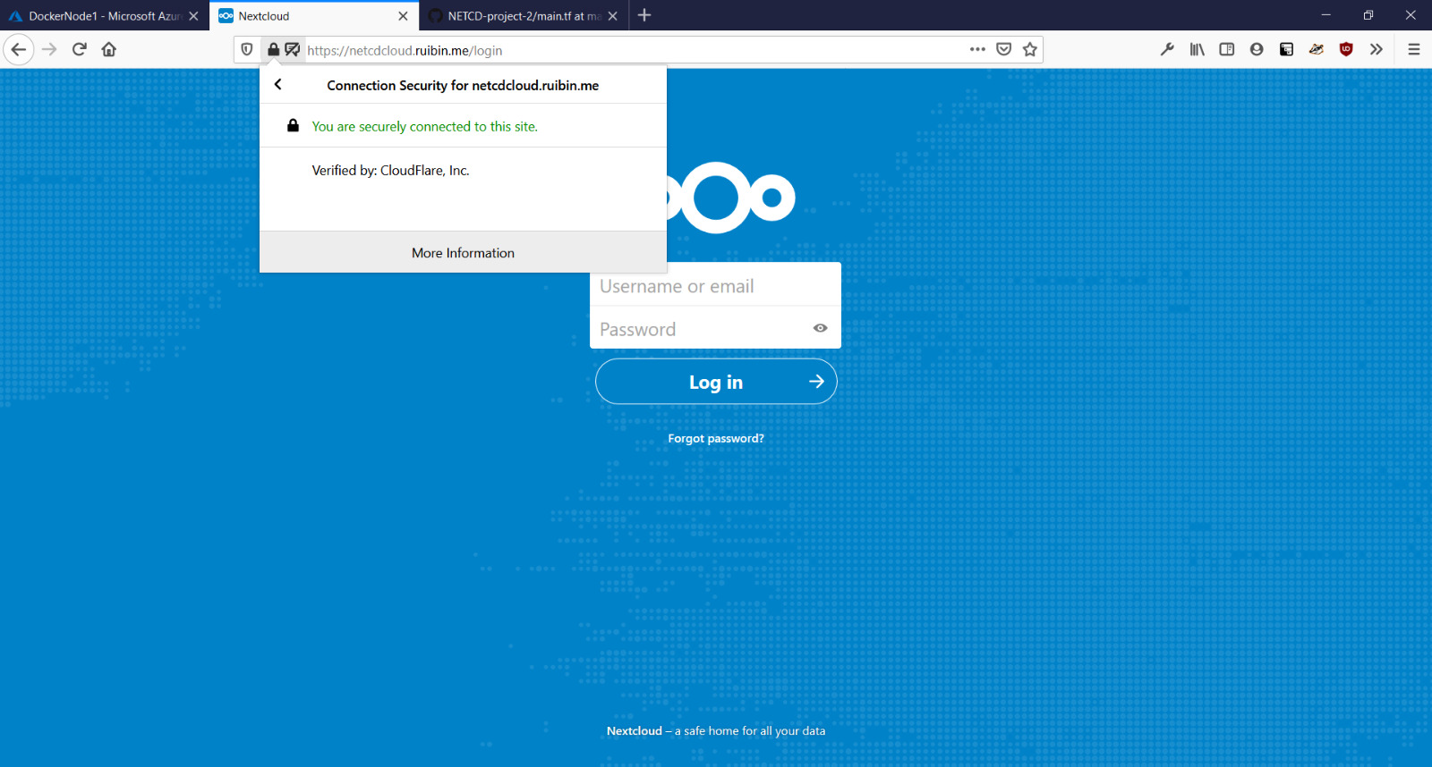
TLS

Slide 16
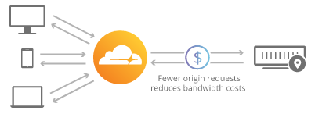
Content Delivery Network
System of distributed servers that deliver web content to a user based on geographic locations of the user
Web pages are cached in servers dispersed at different locations
Reduces the number of requests to server
Increases bandwidth savings
Protection from DDoS

Slide 17
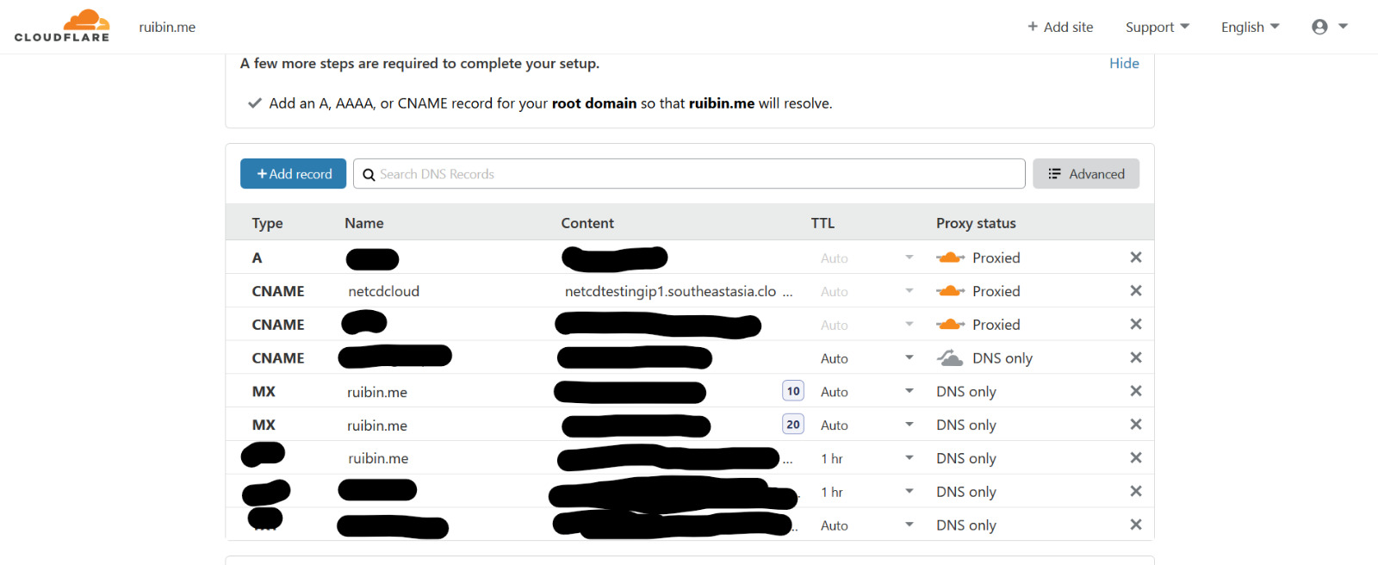
CDN

Slide 18
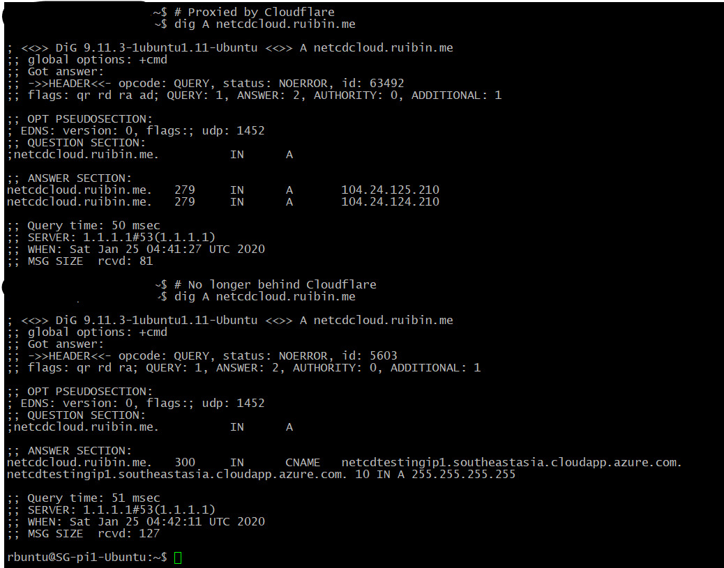
CDN
Different IPs

Slide 19
Web Application Firewall
Filters, monitors and blocks HTTP traffic to and from web applications
Filter by requests, country & etc
User agent strings
Uses rulesets to block common attacks such as XSS and SQL Injections
Notes:
Difference between WAF and reg firewall: WAF able to filter content of specific web app
Firewall server as safety gate between servers

Slide 20
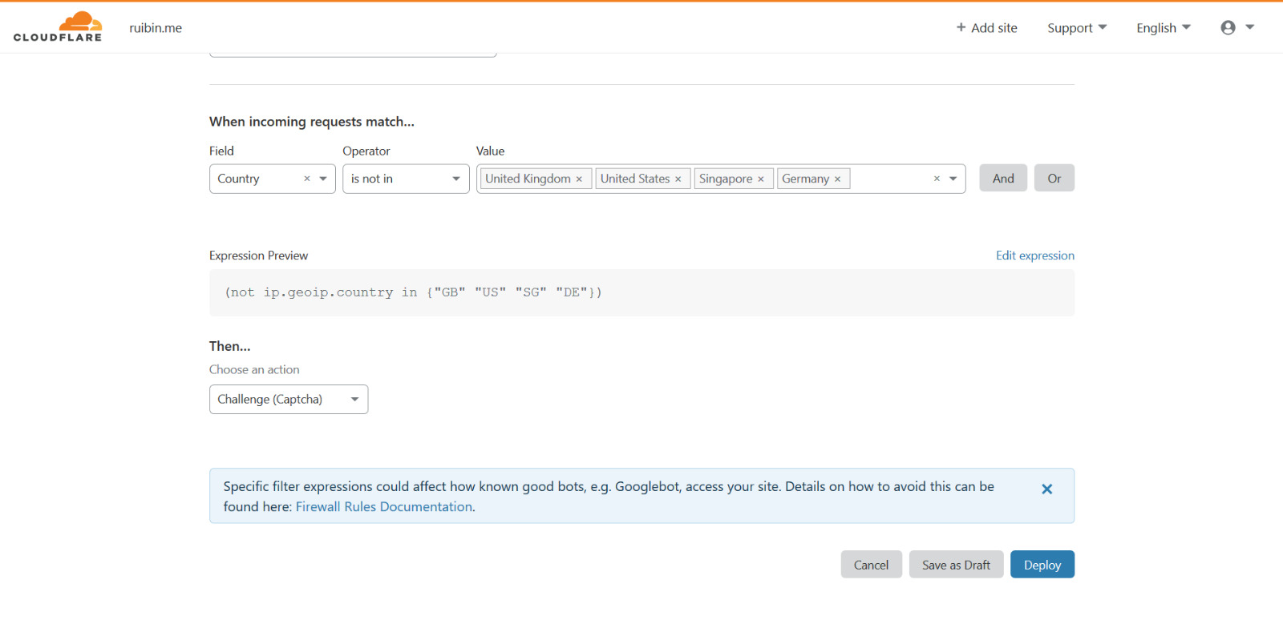
Web Application Firewall

Slide 21
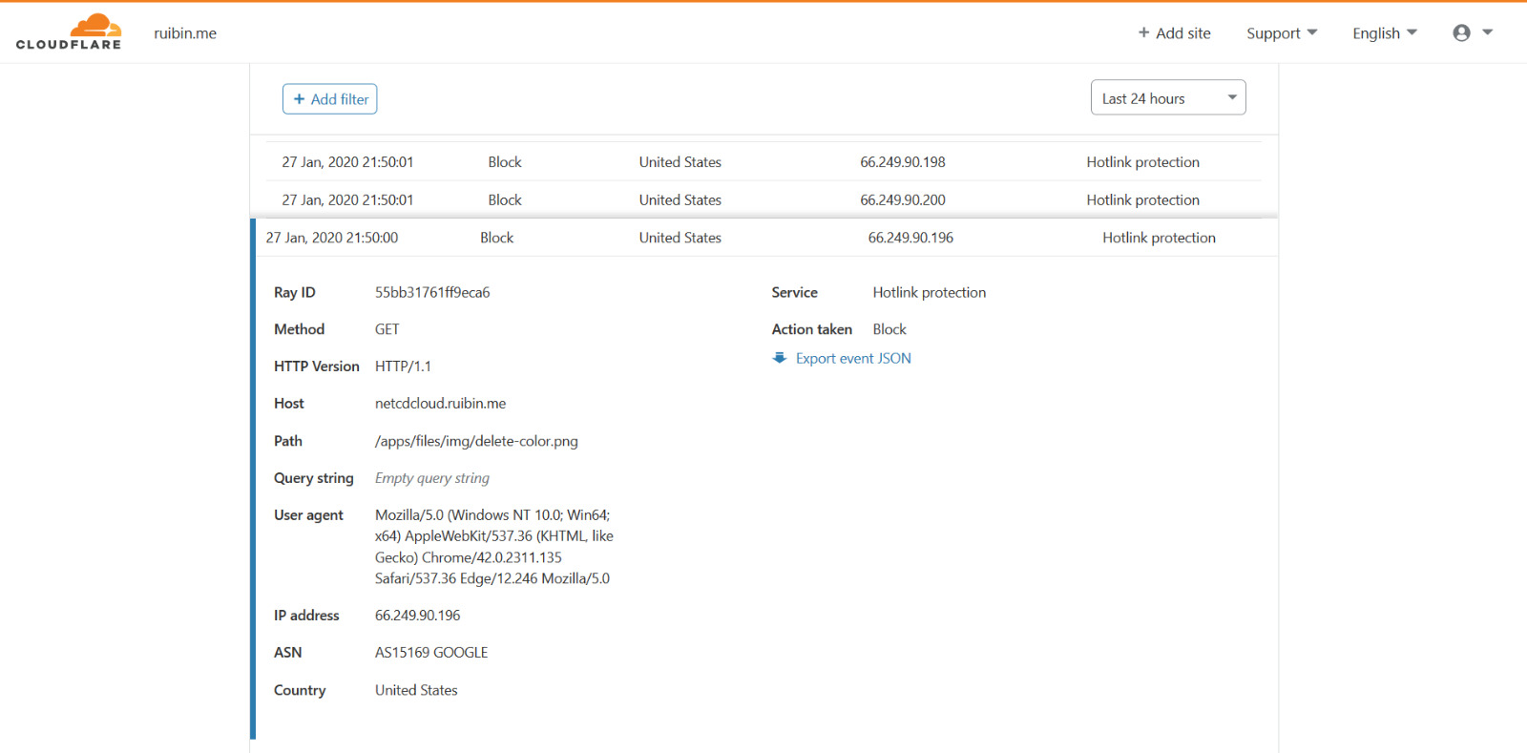
Web protection

Slide 22
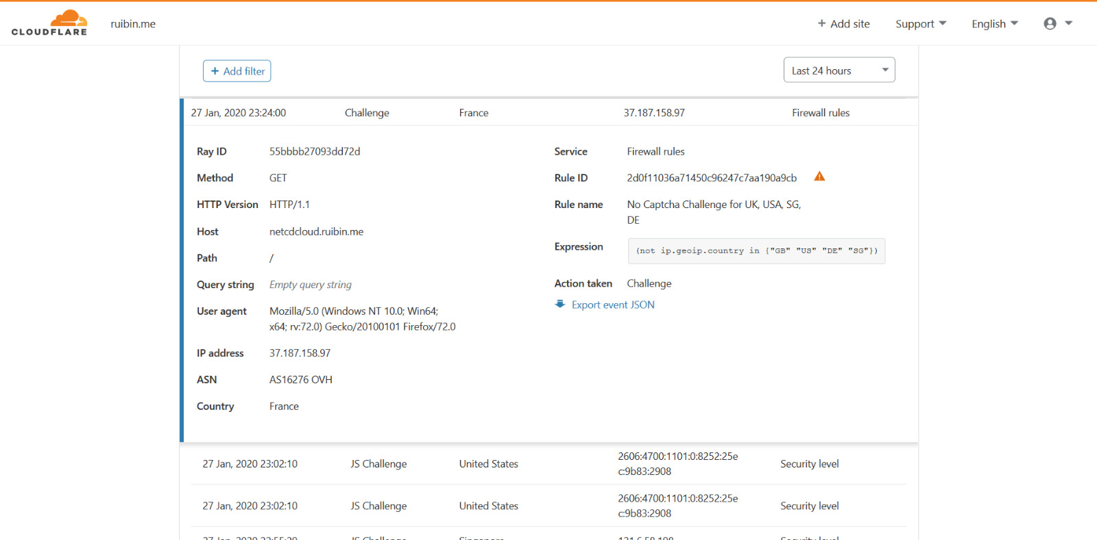
Blocking countries your users are not from

Slide 23
Javascript challenge
Effective mechanism against web application layer attacks
Requires browser on client’s machine to perform a calculation and returns results back to web server
If calculation is accurate: web server returns requested content

Slide 24
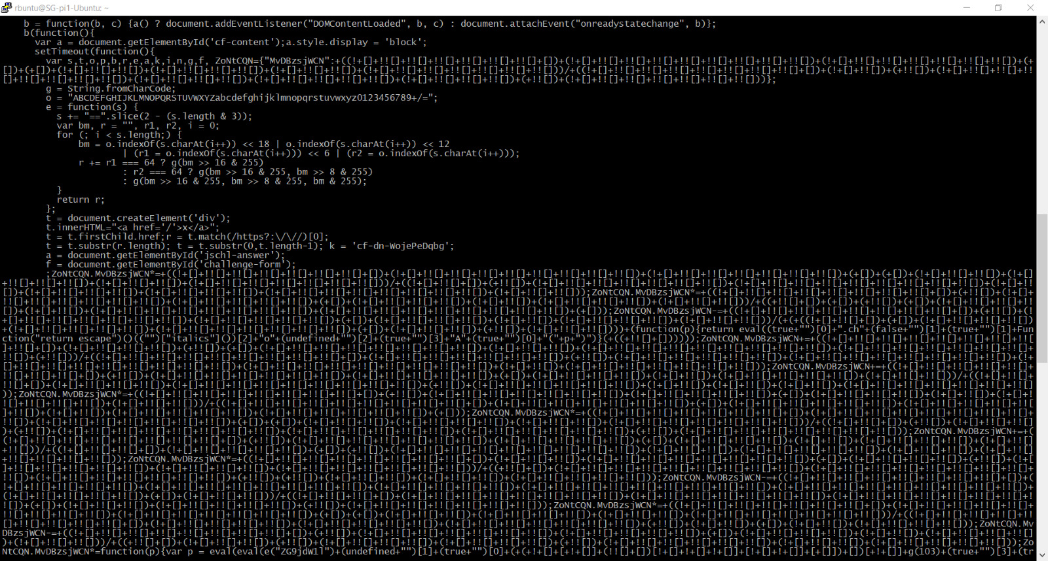
Javascript challenge
A crawler’s perspective

Slide 25
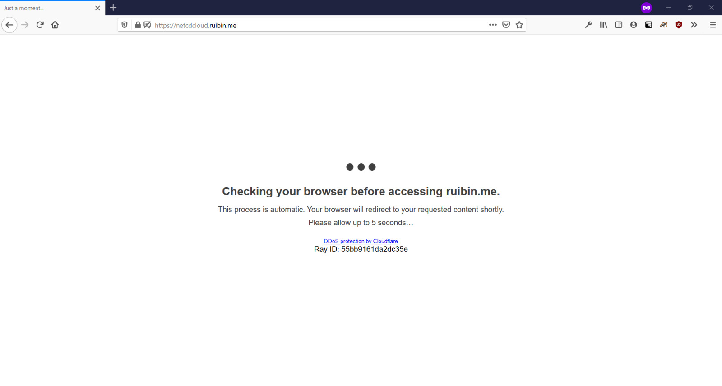
Javascript challenge

Slide 26
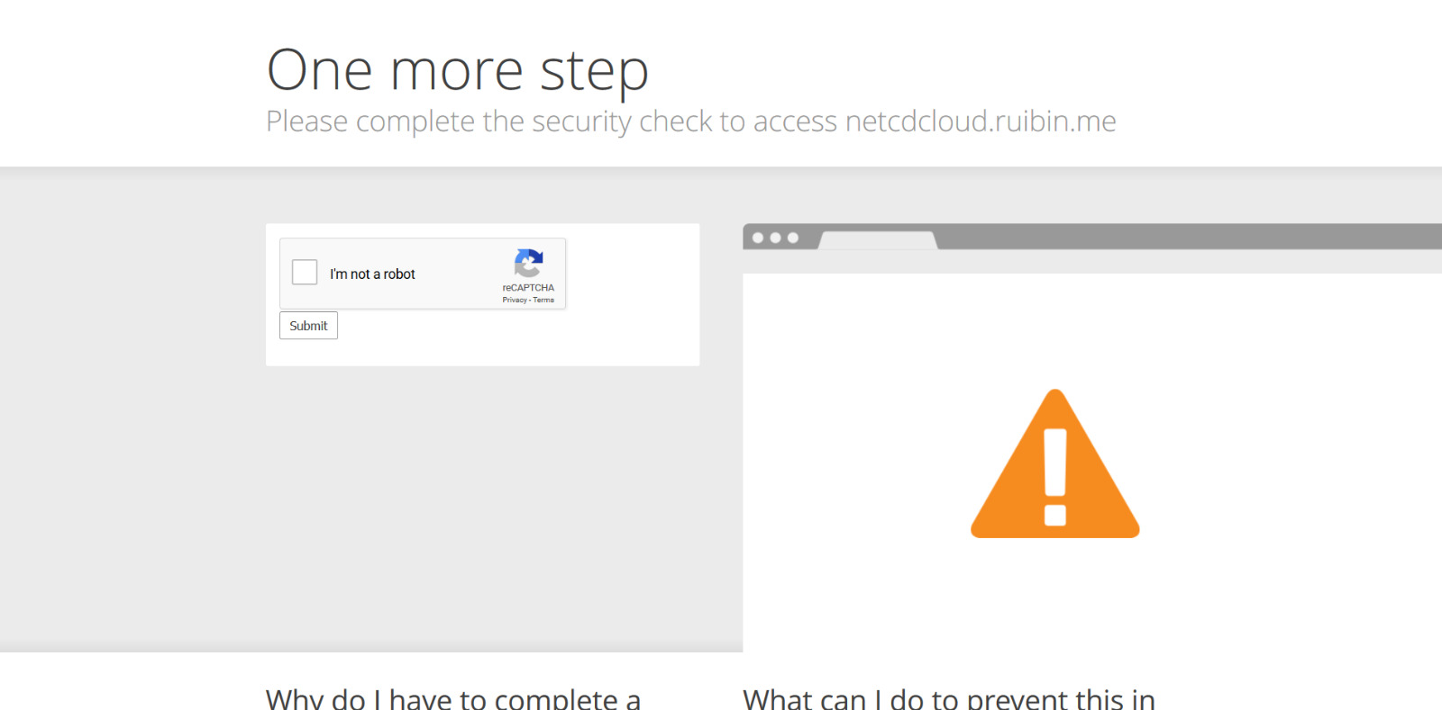
Captcha
For the more intelligent bots

Slide 27
DNSSEC
Verify DNS records using cryptographic signature
Protects from MITM or DNS cache poisoning

Slide 28
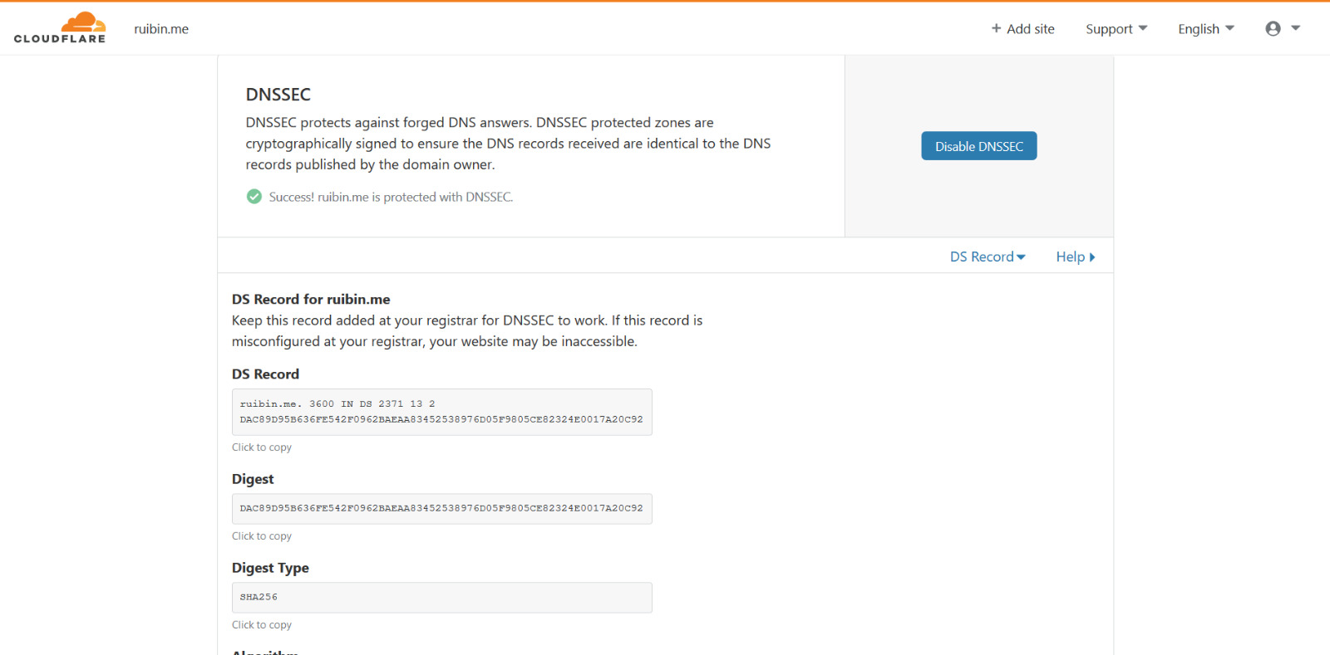
DNSSEC
Things on registrar

Slide 29
Azure Conditional Access
Notes:
Multi-Factor Authentication
defined as a security mechanism that requires an individual to provide two or more credentials in order to authenticate their identity
These can be passwords, hardware tokens, numerical codes, biometrics, time, or location.

Slide 30
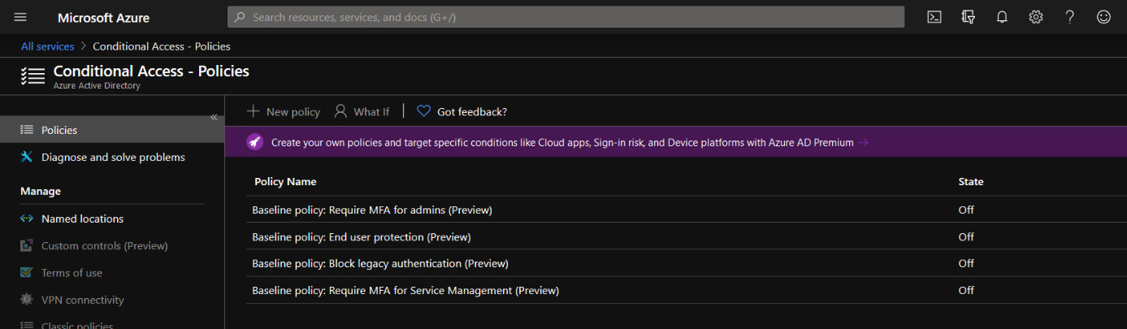
MFA
Notes:
defined as a security mechanism that requires an individual to provide two or more credentials in order to authenticate their identity
These can be passwords, hardware tokens, numerical codes, biometrics, time, or location.

Slide 31
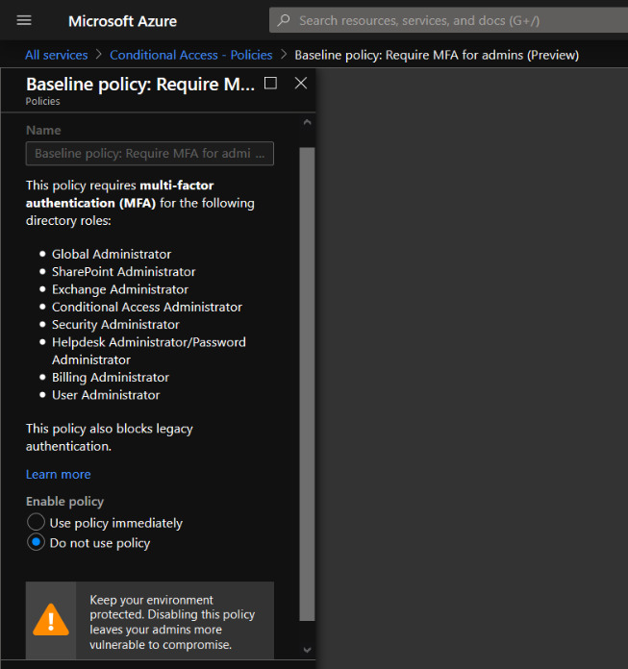

Slide 32
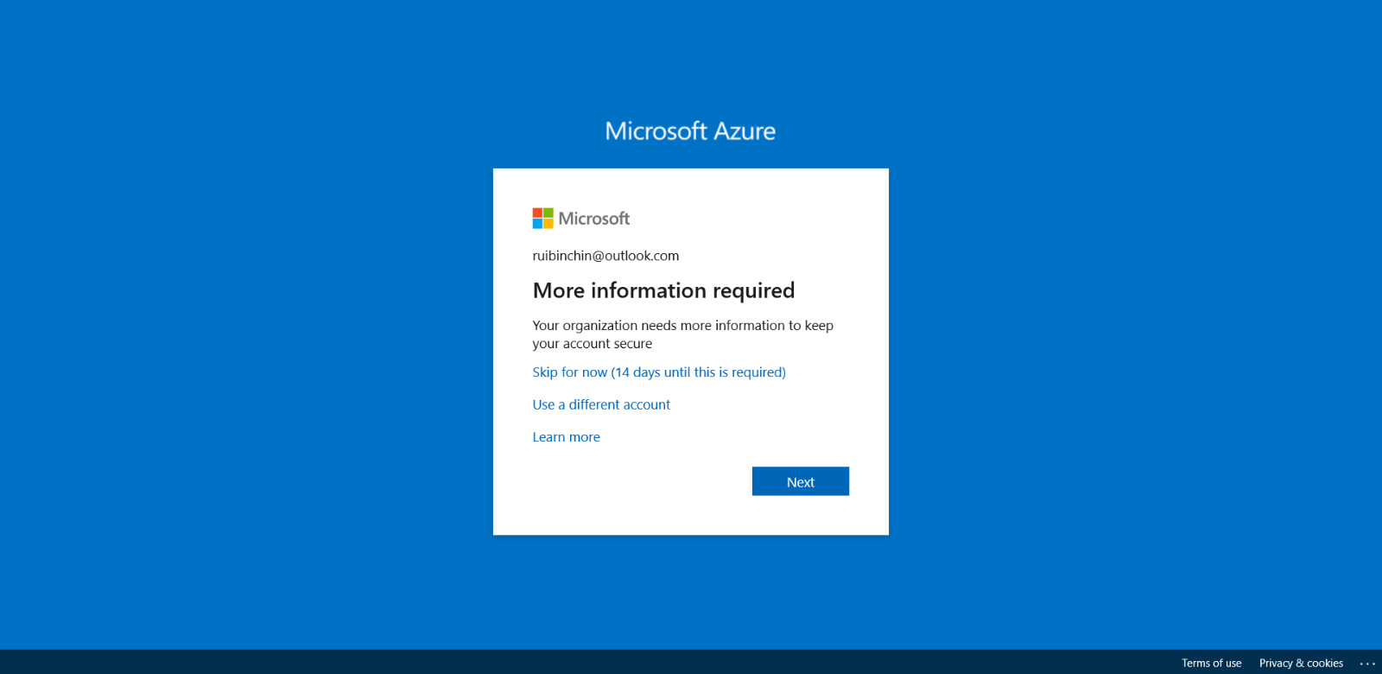
On the next login

Slide 33
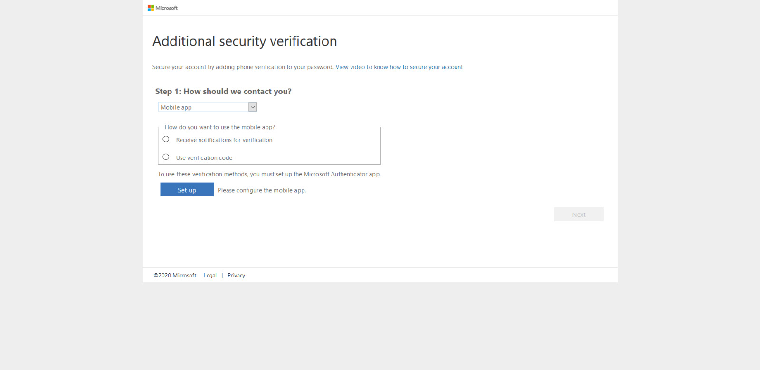
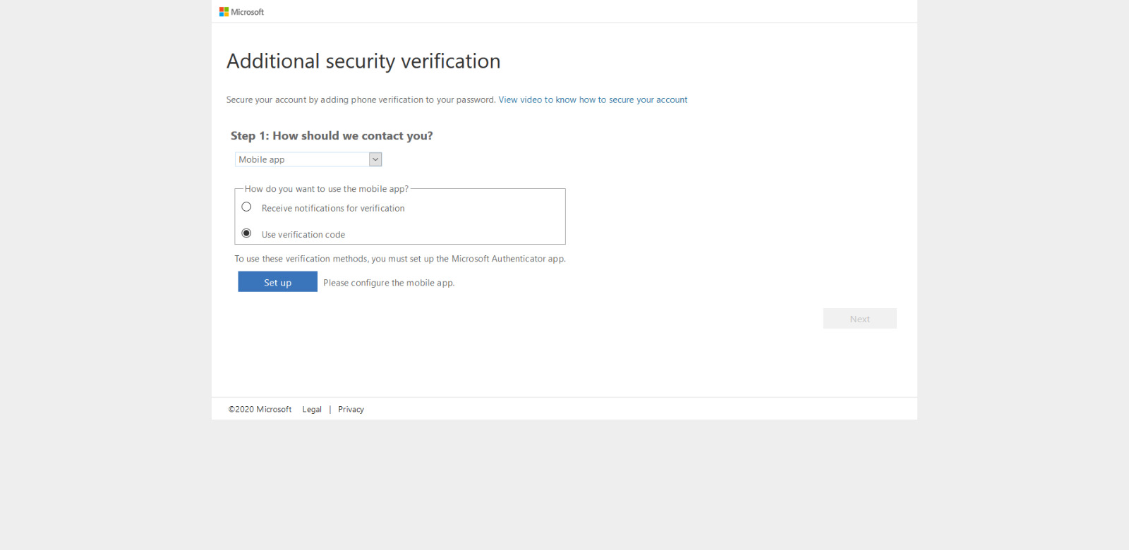

Slide 34
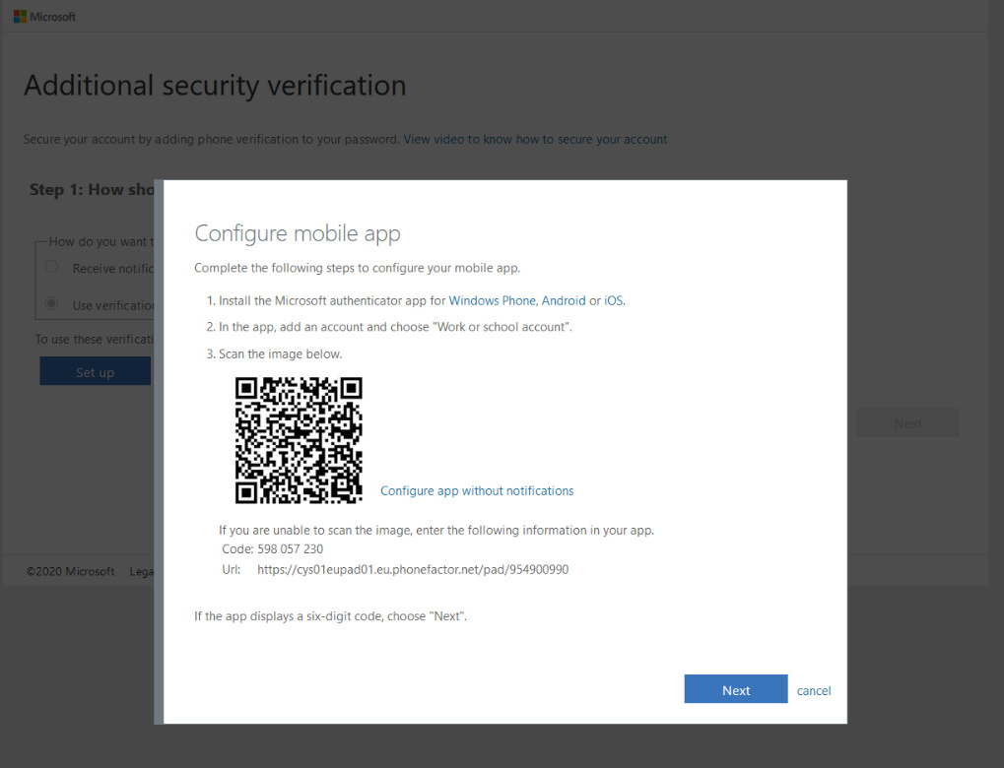

Slide 35
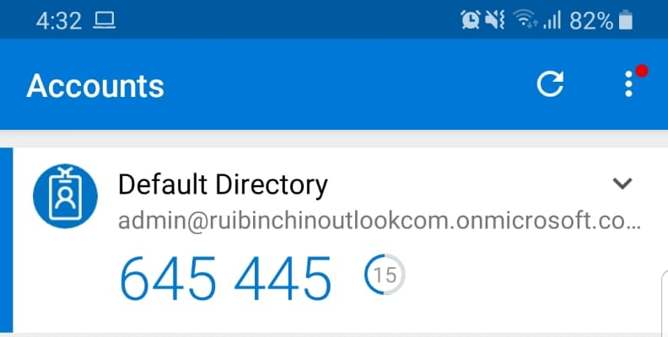
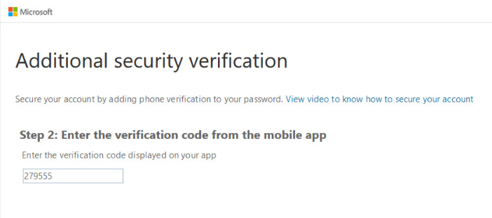
Received verification code on Mobile app
Entering Verification Code on web authentication site

Slide 36
2FA - Nextcloud

Slide 37
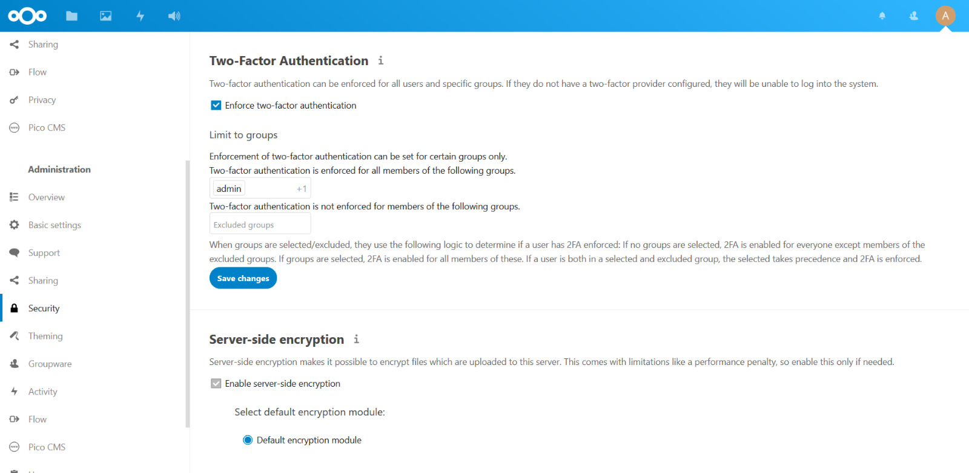

Slide 38
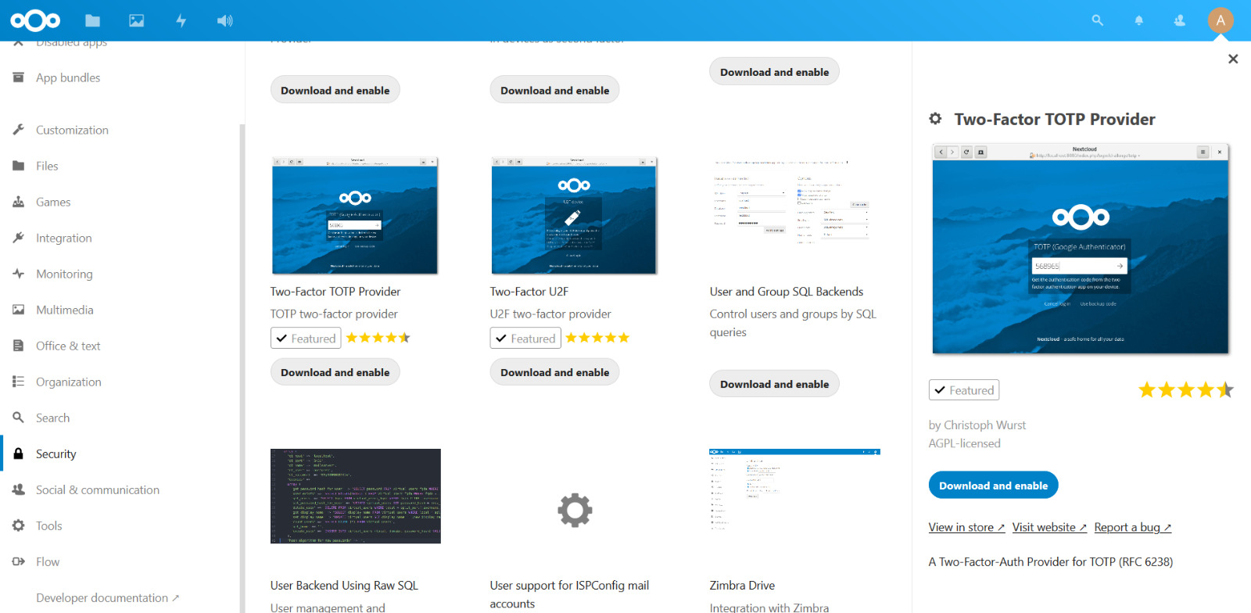

Slide 39
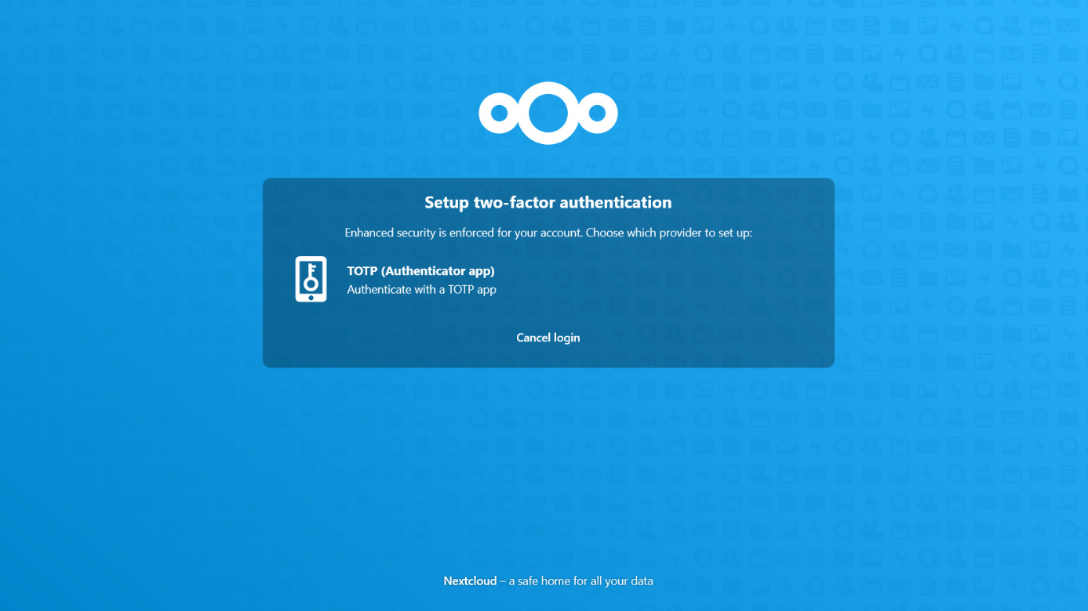
On the next login

Slide 40
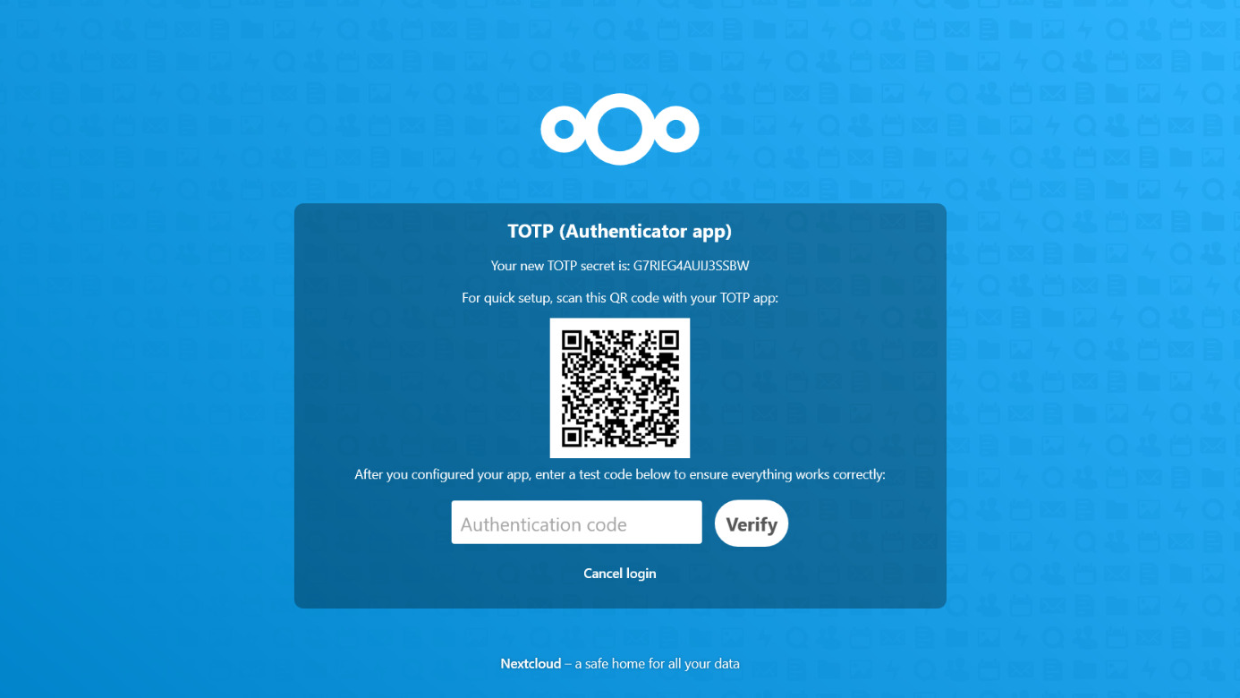

Slide 41
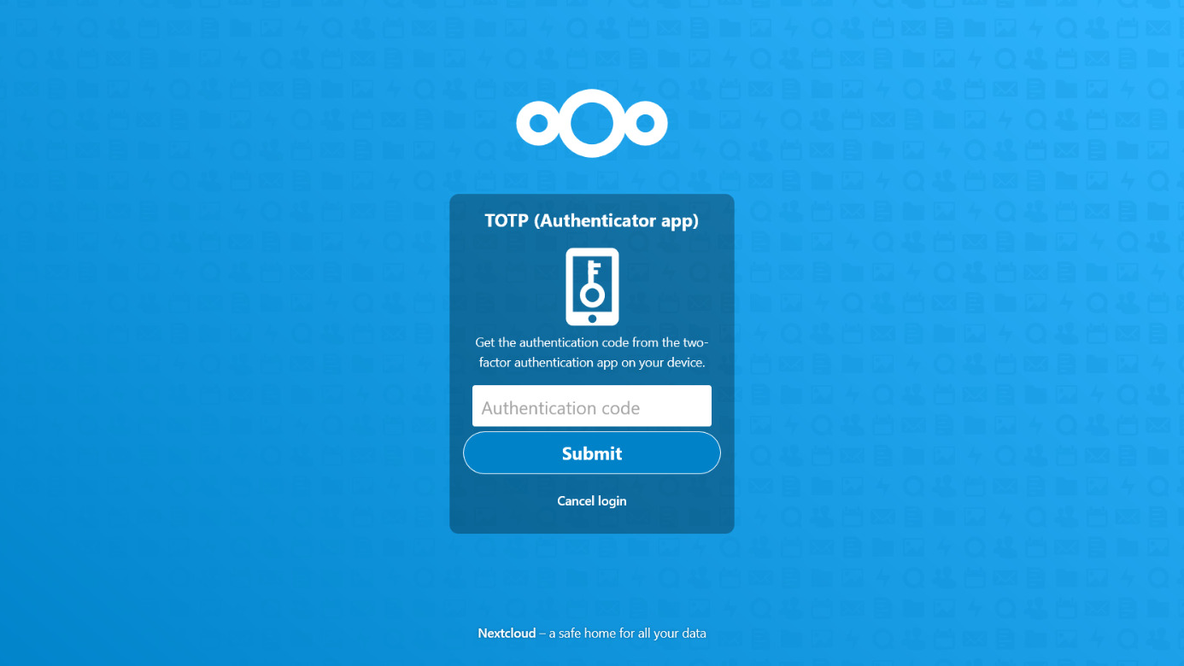

Slide 42
Activity Notifications + Mailgun

Slide 43
Mailgun
Emails as a service
Offers cloud-based email service for sending, receiving and tracking email sent through our websites and applications
Usage:
Email service for activity notification
Free*

Slide 44
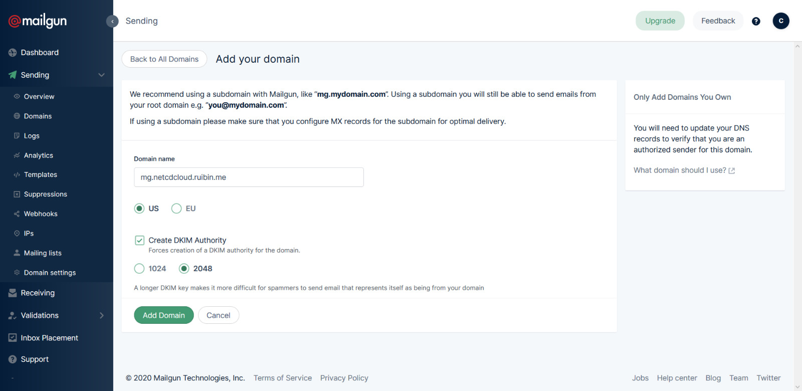
Mailgun
Domain Verification

Slide 45
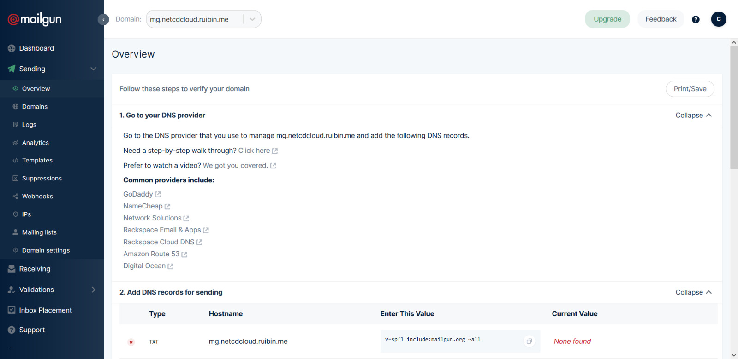
Mailgun
Domain Verification

Slide 46
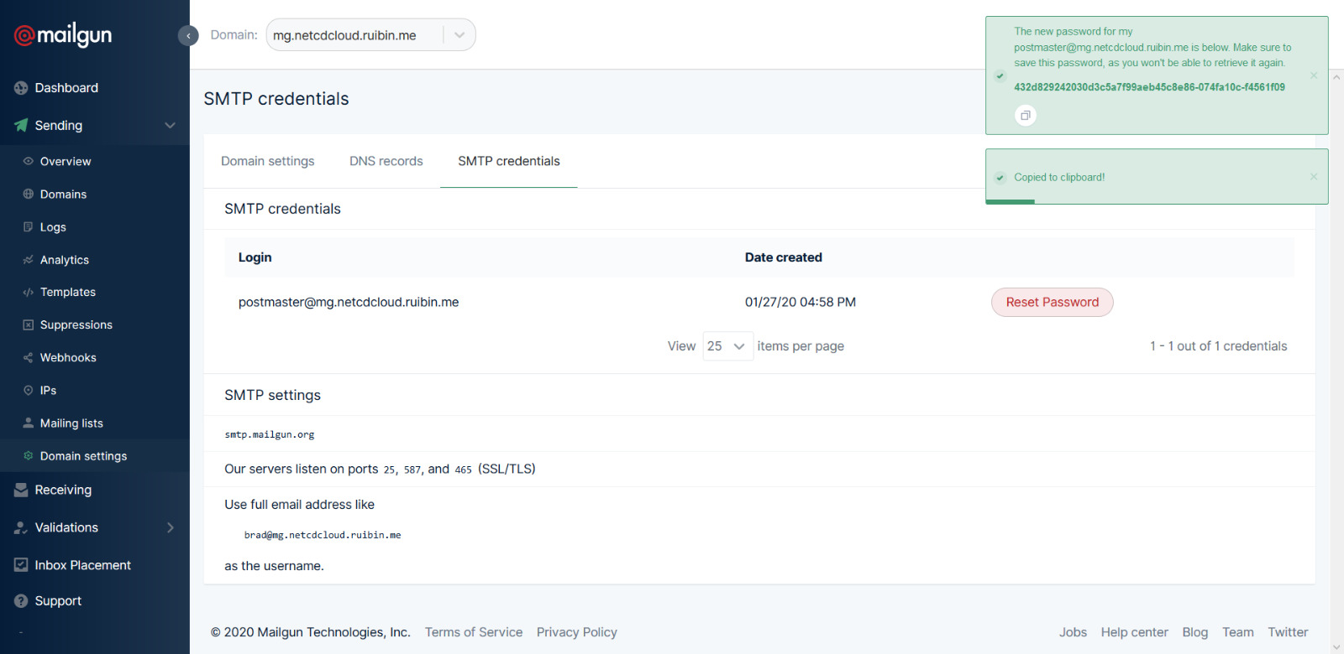
Mailgun

Slide 47
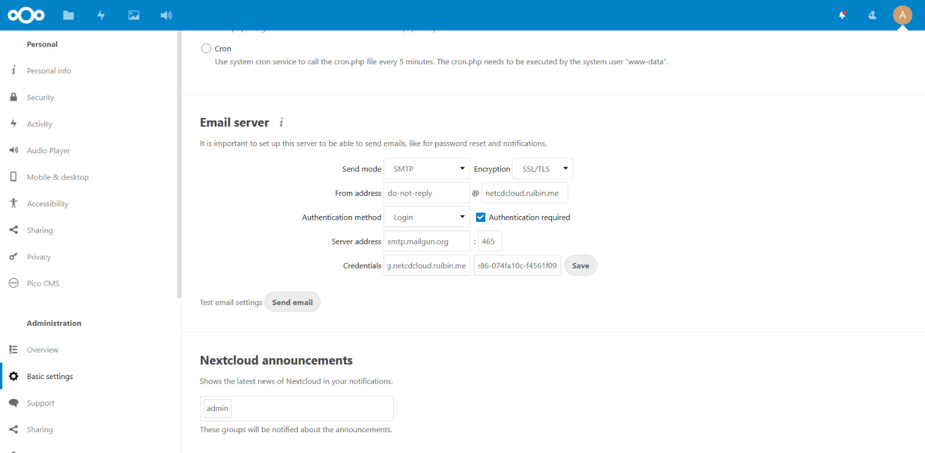
Mailgun
SMTP setup

Slide 48
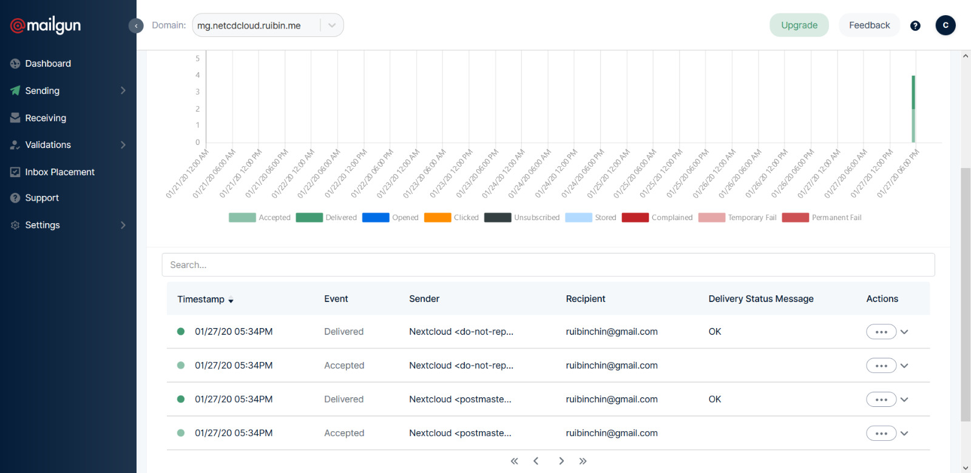
Mailgun

Slide 49
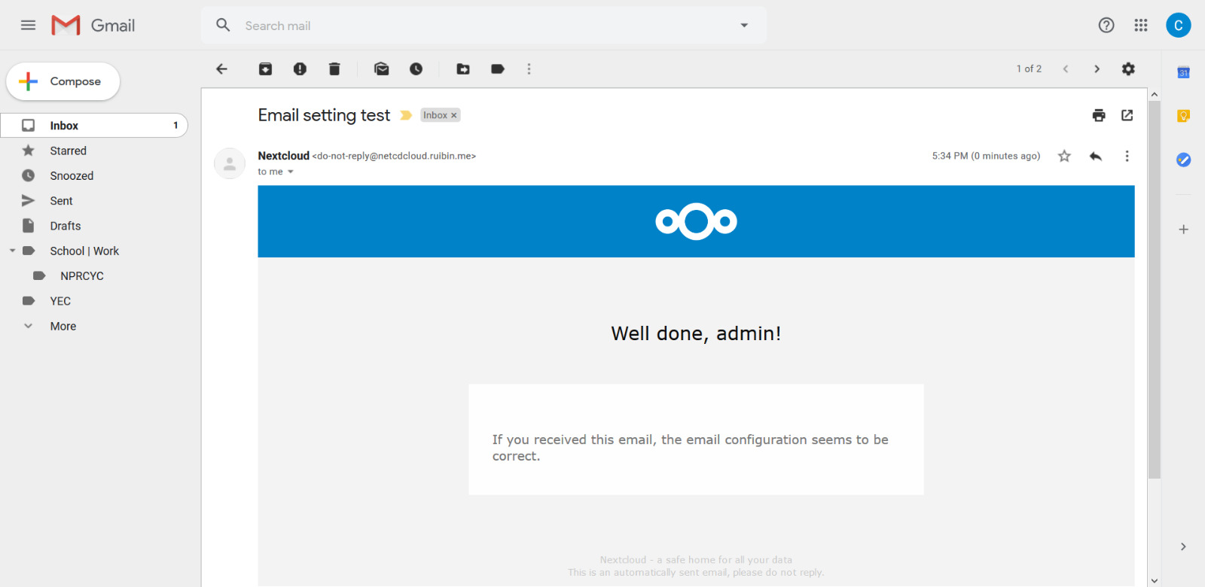
Mailgun

Slide 50
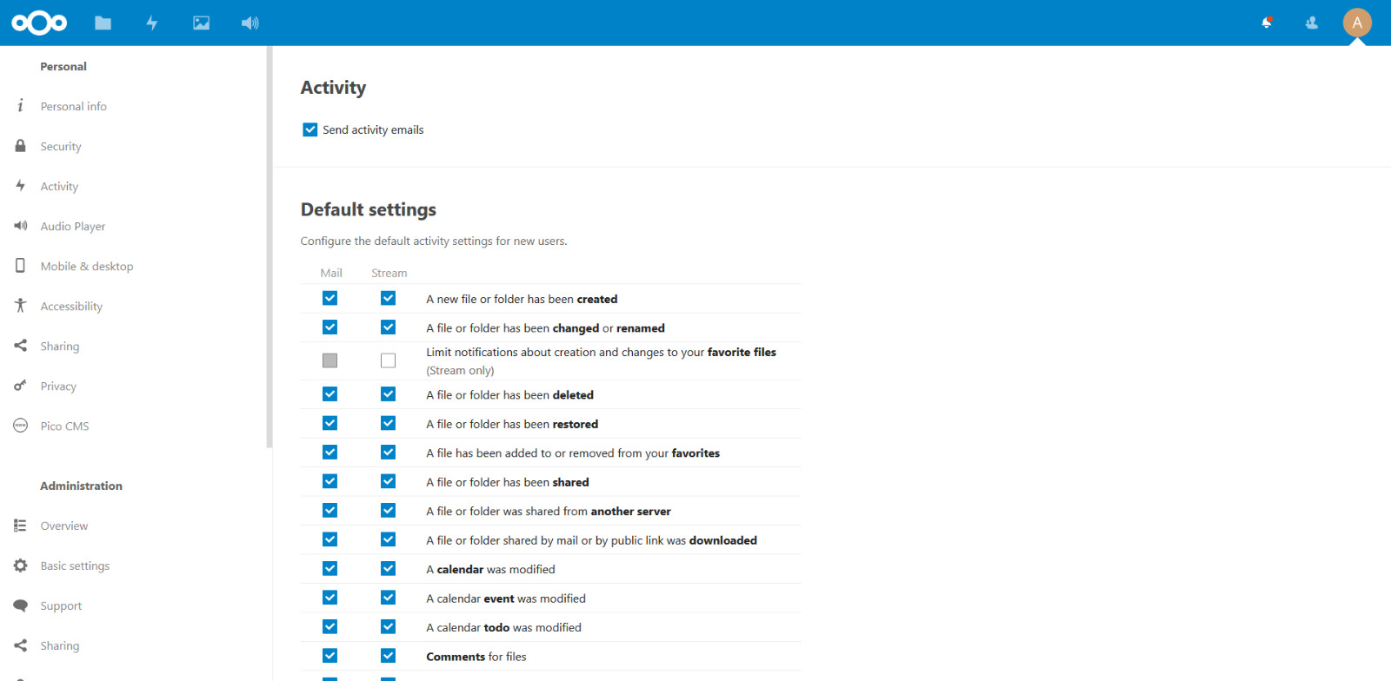
Activity Notifications

Slide 51
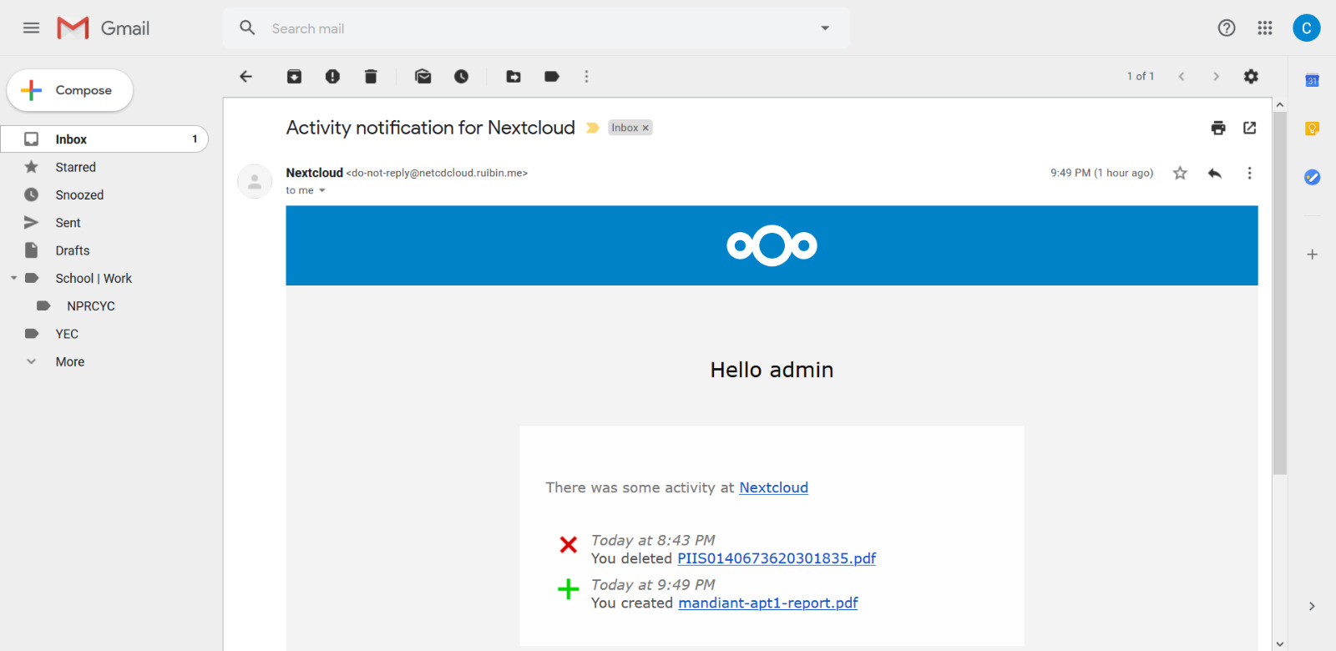
Activity Notifications

Slide 52
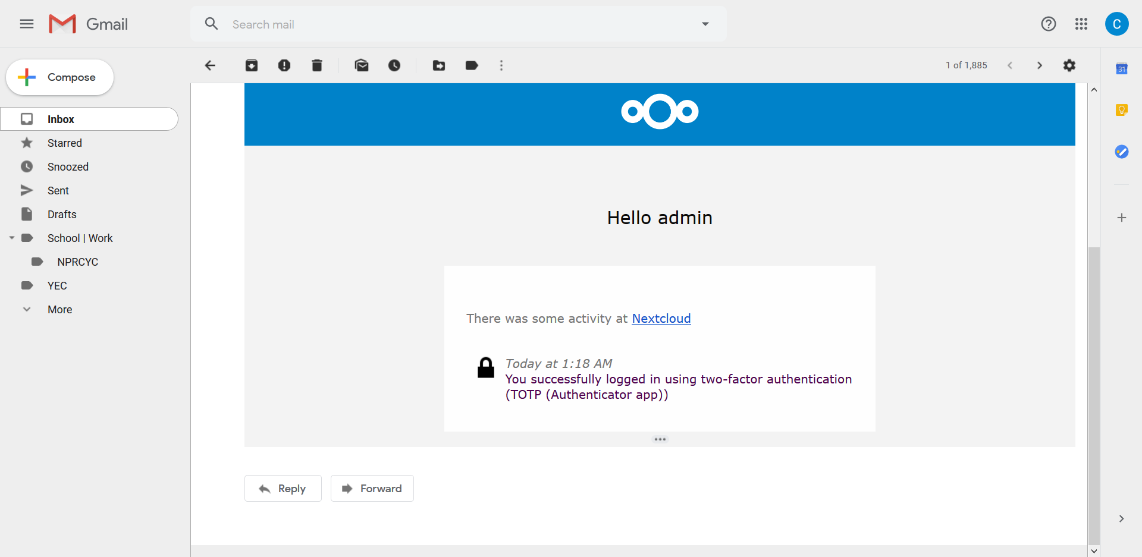
Activity Notifications

Slide 53
Antivirus

Slide 54
Antivirus for files
Antivirus app for NextCloud based on ClamAV
Scans user uploaded files for viruses
Infected files will be deleted and a notification will be shown and/or sent via email

Slide 55
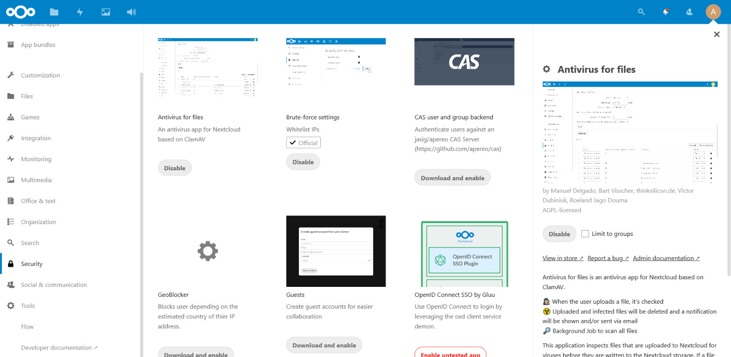
Antivirus

Slide 56
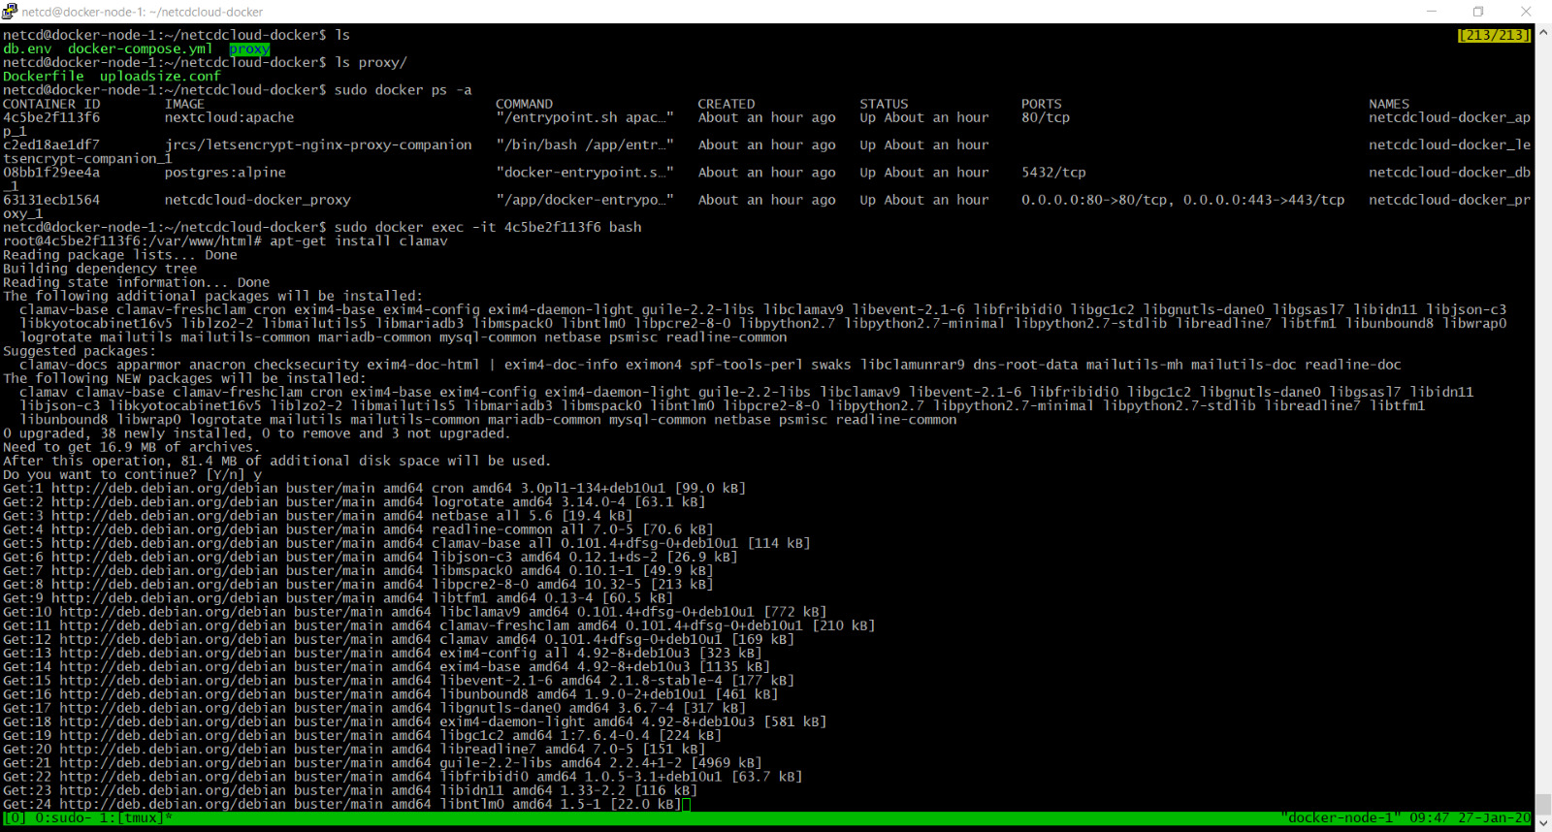
ClamAV Install

Slide 57
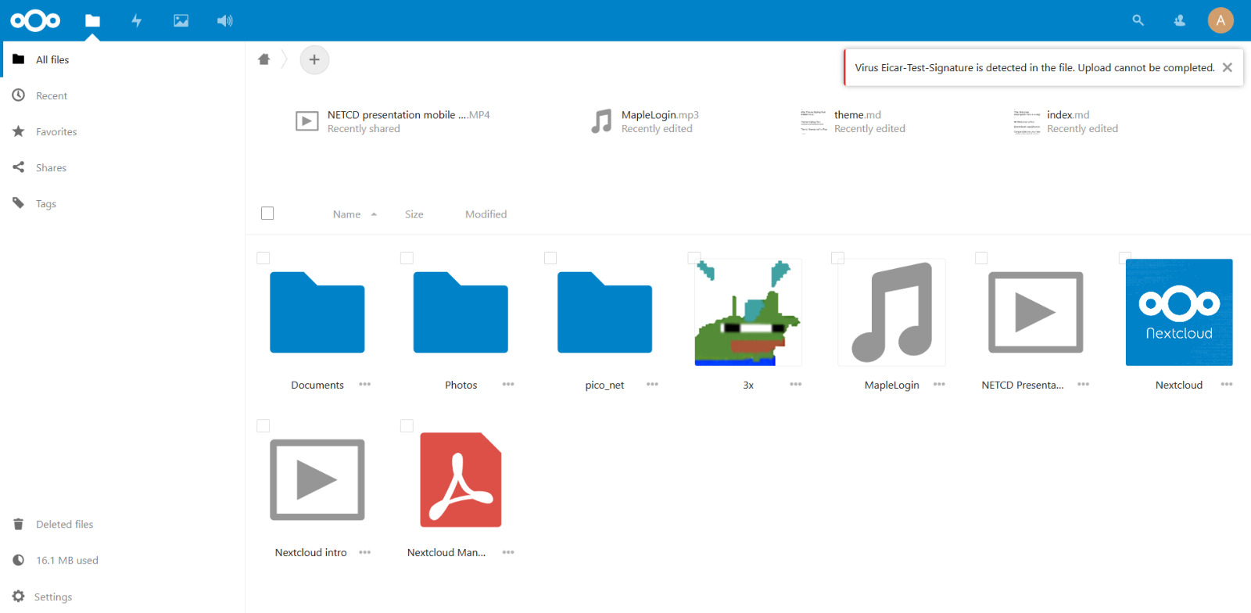
Antivirus

Slide 58
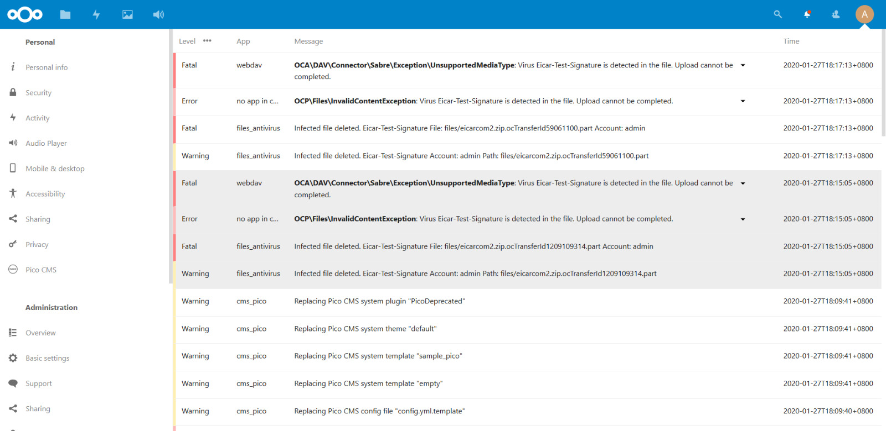
Antivirus

Slide 59
Azure SSO
What did not happen and later did

Slide 60
Azure SSO
Use Azure Active Directory for single sign on
Simplify logins and credentials
SAML is under paid plans
Using OpenID Connect
Refer to DEMO

Slide 61
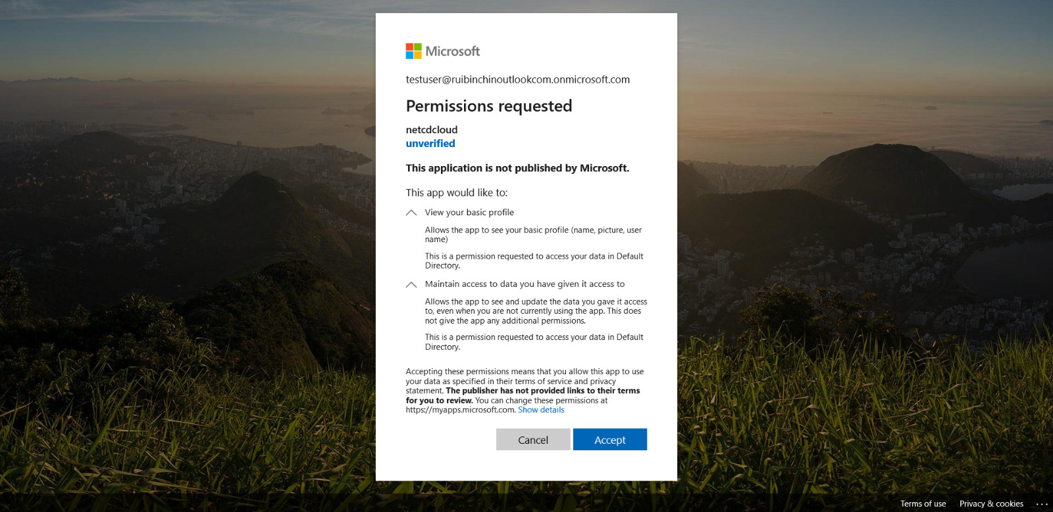
Azure SSO

Slide 62
Challenges Faced

Slide 63
Social Login
SSOs did not work properly
Discord login did not work
Invalid redirect_uri
Redirect_uri generated by the plugin have error
Unable to handle when Discord login successfully using Discord’s generated uri
Telegram’s button simply did not appear
Invalid redirect_uri

Slide 64
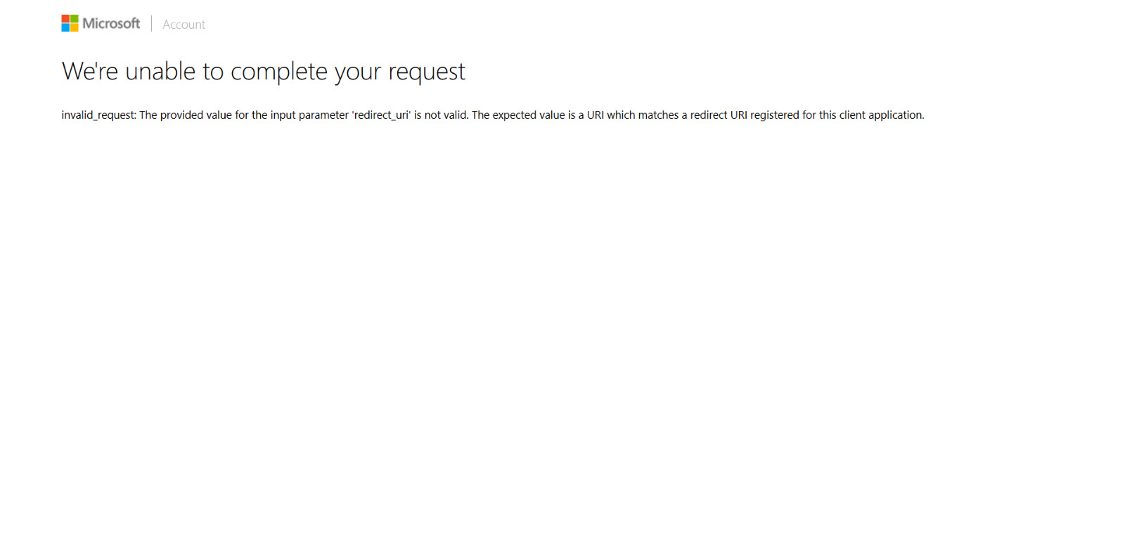
Lack of time to fix this

Slide 65

We could scan the QR code but :/
At this point we suspect a error in the library

Slide 66
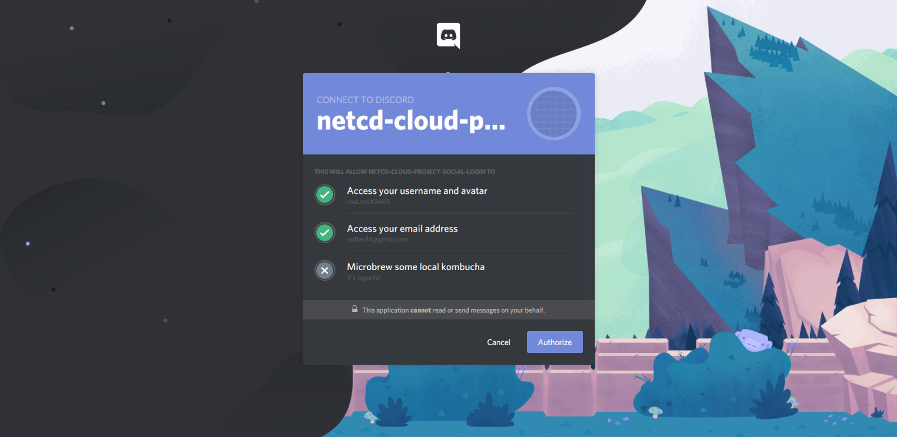
Our largest progress
Using a link manually created by Discord’s developers tools, we manage to get to this stage
At this point we suspect a error in the library / plugin installed.
Lack of time > focus on others
New concepts & complex protocols

Slide 67
Nextcloud
Antivirus need to be separately installed
Paid features
Updates break stuff

Slide 68
References

Slide 69
Thanks yu

